Slide 1
GoVernment college for women A’ Srikakulam, Ambedkar University. project for “noise” team leader:Budida Padmavathi (2102703209) Team member:Dalli sravani(2102703212) team member:devu sailaja(2102703213) team member:dolayi Vijaya laxmi(2102703214) team member:ginni navya(2102703216)
𝐆

Slide 2

Brand Name:Noise

Slide 3
Part -1 brand StUdy Competitor Analysis And Buyer’s /Audience’s persona

Slide 4
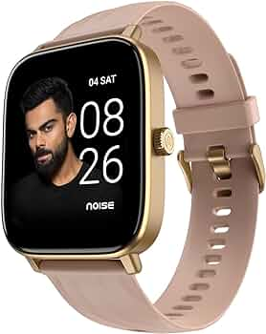
Brand study
Research Brand:
Noise was founded in December 2014 by Amit Khatri and his cousin Gaurav Khatri.The company started as a mobile accessories business but pivoted to smartwatches and other connected devices in 2017. Noise has a strong brand identity and has managed to differentiate itself in a crowded market.Noise has a strong online presence and has managed to leverage social media and digital marketing to reach its target audience.
Productline: Smartwatches Wireless earbuds Fitness trackers Other connected devices

Slide 5
mission/values: Empowering the next generation of Indians with innovative, cutting-edge technology that is both accessible and stylish, to help them stay connected, active, and inspired. 1. Innovation: Noise is committed to staying ahead of the curve with the latest technology and design trends. 2. Style: Noise believes that technology should be both functional and fashionable. 3.Customer Obsession*: Noise is dedicated to delivering exceptional customer experiences and building strong relationships with its customers. 4. Teamwork: Noise values collaboration, creativity, and innovation within its team to drive growth and success. 5.Integrity: Noise operates with transparency, honesty, and ethical business practices. These values and mission drive Noise’s decisions, product development, and customer interactions, aiming to create a strong brand identity and loyal community.

Slide 6
Usp(unique Selling proposition)of noise
Budget-friendly: Noise products are affordable and offer great value for money. Stylish designs:Noise products look modern and trendy, making them a fashion statement. Long-lasting battery:Noise products have long battery life, so you don’t need to recharge them frequently. Health and fitness features:Noise products help you track your fitness goals, monitor your health, and stay active. Water-resistant:Many Noise products can withstand water and dust, making them durable and long-lasting.
Easy connectivity: Noise products pair easily with your phone, making it simple to use them. Regular updates: Noise keeps its products up-to-date with the latest features and security patches. Good customer support:Noise prioritizes customer satisfaction and offers helpful support. Indian brand:Noise is an Indian company, making it a preferred choice for those who support local businesses. These USPs make Noise products attractive and appealing to customers, offering a unique combination of style, functionality, and value.

Slide 7
Analyse Brand tone and identity
Brand tone: ￼￼￼￼￼￼￼
The Brand tone of noise is a dynamic blend of energy, innovation,and friendliness,making it a popular choice among the young and tech –Savvy audience.
Brand identity :
The brand identity of Noise refers to the unique personality, image, and reputation of the Noise brand, encompassing Visual Identity,Tone of Voice , Brand Values ,Brand Personality ,Product Design and Quality,Customer Experience , Customer Service, Marketing Strategies,Advertising Strategies and Digital Presence .

Slide 8
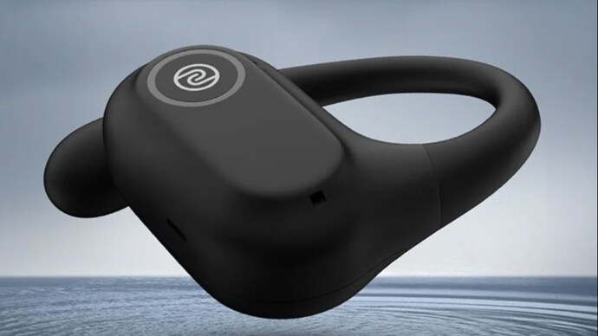
Brand identity
1.Logo :The logo would look bold and attention-grabbing, maybe with sharp lines or funky designs.
2. Colors: Think of bold colors like red, black, or electric blue that make you feel energetic and alive.
3. Typography: The words they use would be strong and in-your-face, like big, bold letters that demand attention.
4. Messages: Their messages would be direct and might challenge the way things are normally done. They want to shake things up!
5. Images: Their pictures and videos would be exciting and full of energy, like people having fun or standing up for what they believe in.

Slide 9
Smart goals and kpis
Here are five SMART goals along with their Key Performance Indicators (KPIs)
1. Goal:Specific
KPI: Monthly sales revenue growth compared to the previous year. 2. Goal:Measurable KPI: Average customer rating and feedback on review platforms like Amazon, Trustpilot, or the brand’s website.
3.Goal:Achievable
KPI: Number of new retail partnerships established and the volume of Noise products sold through these channels. 4.Goal:Relevant KPI: Growth in the number of followers on social media platforms such as Instagram, Twitter, and Facebook. 5. Goal:Time-bound
KPI: Timely completion of product development milestones and successful launch within the specified timeframe.

Slide 10
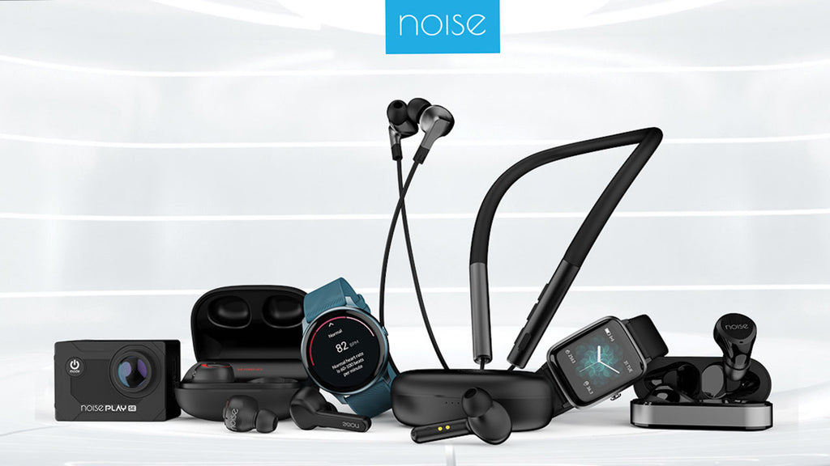
Buyer’s /audience’s persona

Slide 11
the target audience for noise brand can be defines as follows: 1)Age group 2) Demographics 3)Psychographics 4)Behavioral traits 5)Goals and motivations

Slide 12
Age group:
The age group for the Noise brand’s target audience typically ranges from young adults to middle-aged individuals, roughly between 18 to 45 years old. This demographic encompasses tech-savvy consumers who appreciate quality audio products, including headphones and earbuds, for various purposes such as music listening, gaming, and work.
Demographics:
Gender: Both Male and Female. Income:Middle to upper-middleclass. Values:Health ,wellness, innovation,and self-expression.
Psychographics: Interests: Music, podcasts, audiobooks, fitness Lifestyle: Active, social, tech-savvy Pain Points: Distractions while working or traveling, discomfort from ambient noise, desire for premium audio experiences

Slide 13
Behavioral traits:
Researches extensively before making purchasing decisions Values recommendations from trusted sources, including online reviews and social media influencers Willing to invest in high-quality products that offer superior performance and features.
goals and motivations: Seeking headphones that provide excellent sound quality and noise-canceling features for immersive listening experiences Interested in staying updated with the latest technology trends and innovations in audio products Values convenience and versatility, such as wireless connectivity and long battery life Desires headphones that are comfortable for extended wear during work, travel, or workouts.

Slide 14
Competitor Analysis

Slide 15
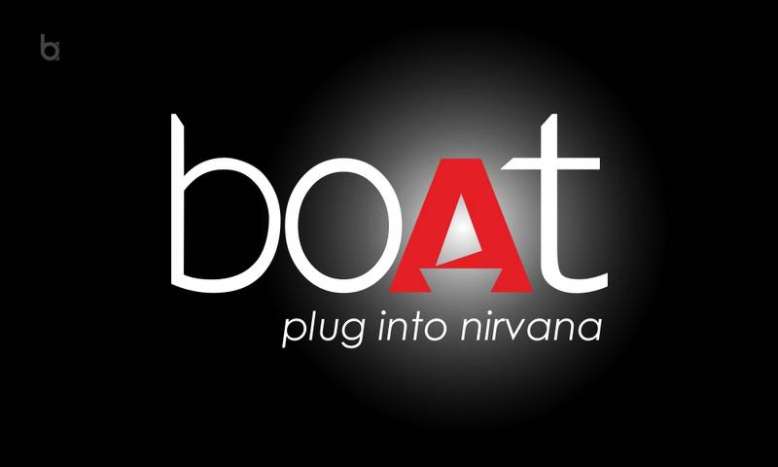
Competitor-1:Boat
Boat:
usp:The USP (Unique Selling Proposition) of the Boat brand is its fusion of style, performance, and durability, offering consumers innovative audio and lifestyle products tailored to modern needs.
Online communication: Boat excels in online communication through engaging social media campaigns, influencer collaborations, and interactive content that resonates with their target audience, keeping them connected and informed about the latest products and trends in the audio and lifestyle space.

Slide 16
Swot analysis
Strengths: Innovative Products,Strong Online Presence,Affordable Pricing,Good Quality and Strong Customer Service. Weaknesses: Limited Offline Presence,Dependence on Online Sales,Limited Product Range,High Marketing Costs,Competition from EstablishedBrands. Opportunities: Growing Demand for Wireless Audio,Expanding into New Markets,Diversifying Product Range,Partnerships and CollaborationsAdvancements in Technology. Threats: Intense Competition,Rapidly Changing Technology,Economic Uncertainty,Counterfeit Products and Regulatory Changes.

Slide 17

Competitor-2:Realme
Realme:
usp:Realme stands out by offering cool, high-tech features in their smartphones at prices that won’t break the bank, making them a top choice for young people who want the latest tech without spending a fortune.
Online communication:
Realme talks to people online by sharing fun stuff on social media, teaming up with cool people, and making it easy to find out about their new phones and other gadgets.

Slide 18
Swot analysis
Strengths Innovative Products,Affordable Pricing,strong Online Presence,Good Quality and Fast Growth. Weaknesses:
Limited Offline Presence,Dependence on Online Sales,Limited Brand Recognition, High Marketing Costs and Competition from Established Brands. Opportunities: Growing Demand for Smartphones,Expanding into New Markets,Diversifying Product Range,Partnerships and Collaborations and Advancements in Technology* Threats: Intense Competition,Rapidly Changing Technology,Economic Uncertainty,Counterfeit Products and Regulatory Changes.

Slide 19

Competitor-3:Sony
Sony:
usp:Sony makes top-notch products that are always ahead of the curve in technology and quality, earning trust and admiration from people all over the world.
Online communication:
Sony talks to people online by sharing fun and interesting things about their products, like movies, music, and games, making it easy for everyone to stay connected and entertained.

Slide 20
Swot analysis
Strengths: Global Recognition, Diversified Product Portfolio,Innovation,Strong Brand Loyalty,Financial Resources. Weaknesses: Dependence on Electronics Segment,Declining TV Sales,intense Competition,High Research and Development Costs
Product Recalls and Quality Issues Opportunities: Growing Demand for Gaming and Entertainment,Expansion into Emerging Markets,Diversification into New Products and Services,Partnerships and Collaborations ,Advancements in Technology. Threats: Intense Competition,Rapidly Changing Technology,Economic Uncertainty,Currency Fluctuations.

Slide 21
Part-2 seo& keyword research

Slide 22

Seo Audit

Slide 23
On page optimisation

Slide 24
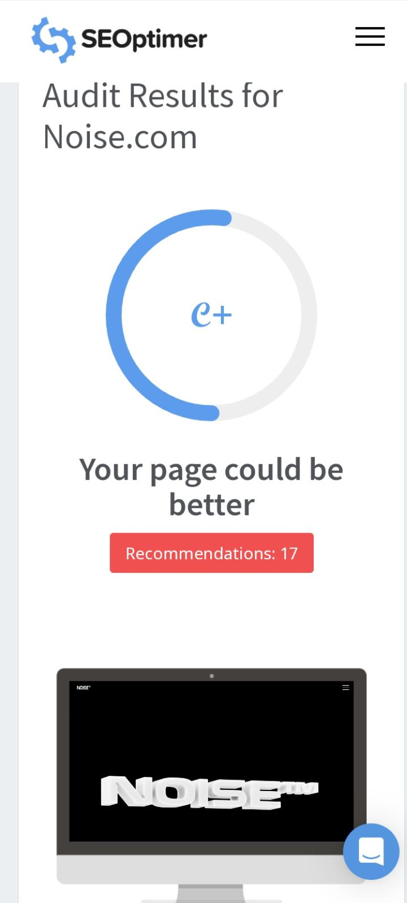
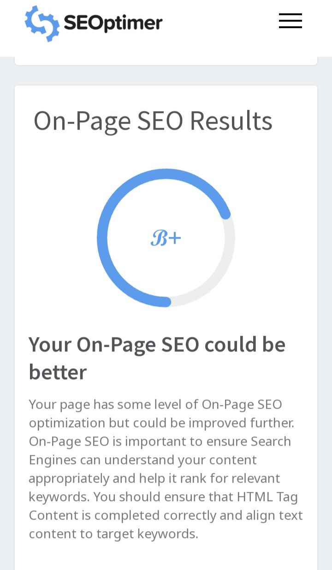

Slide 25
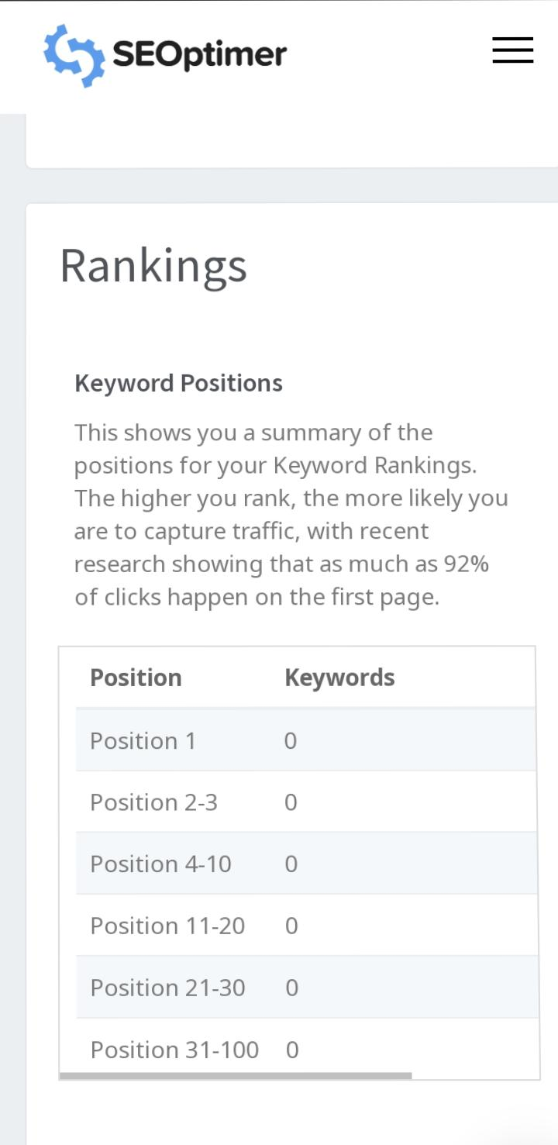
Rankings

Slide 26
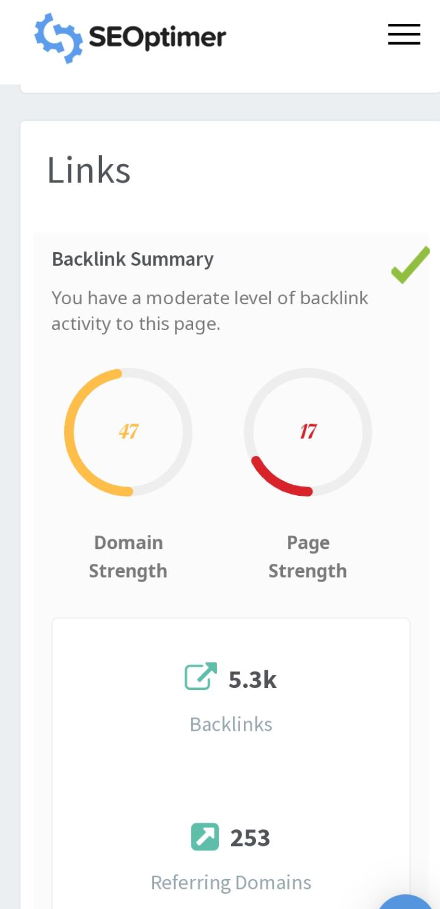
Links

Slide 27
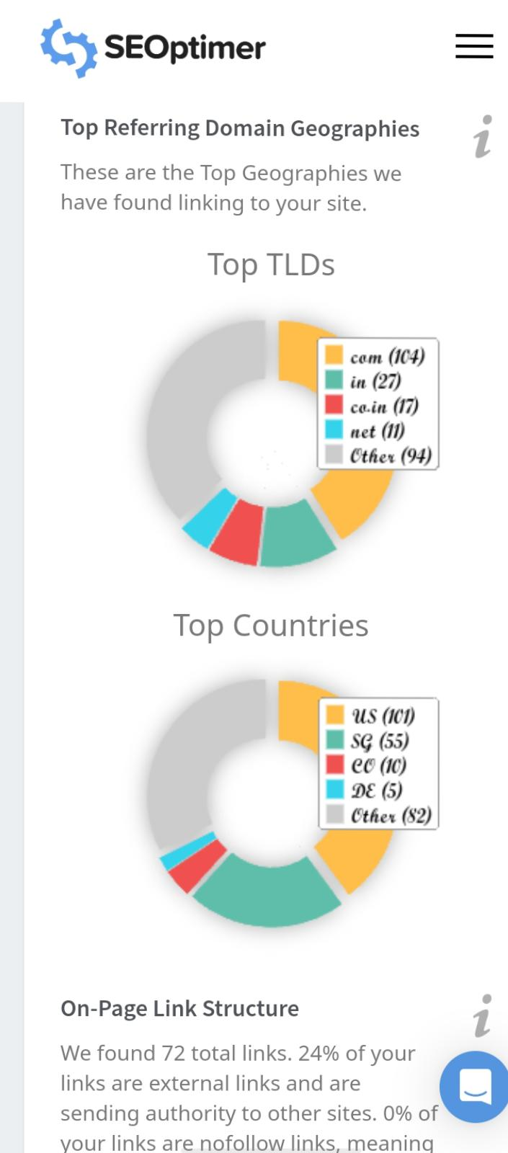
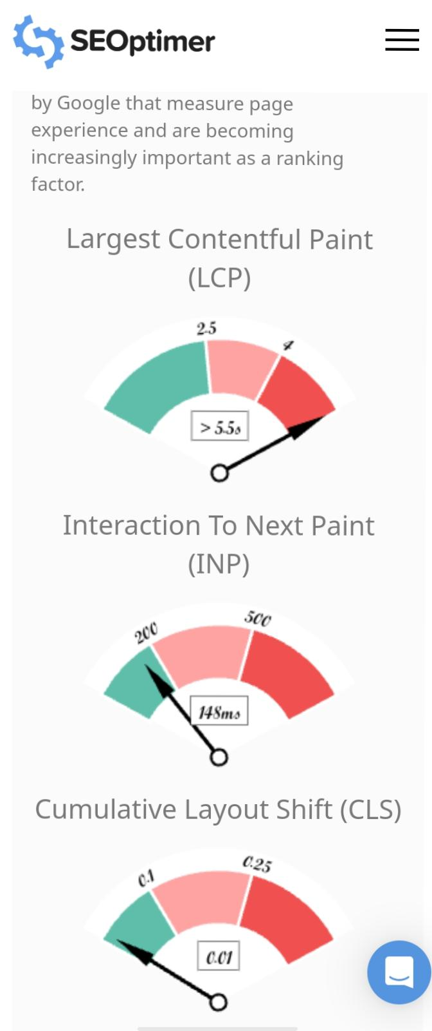
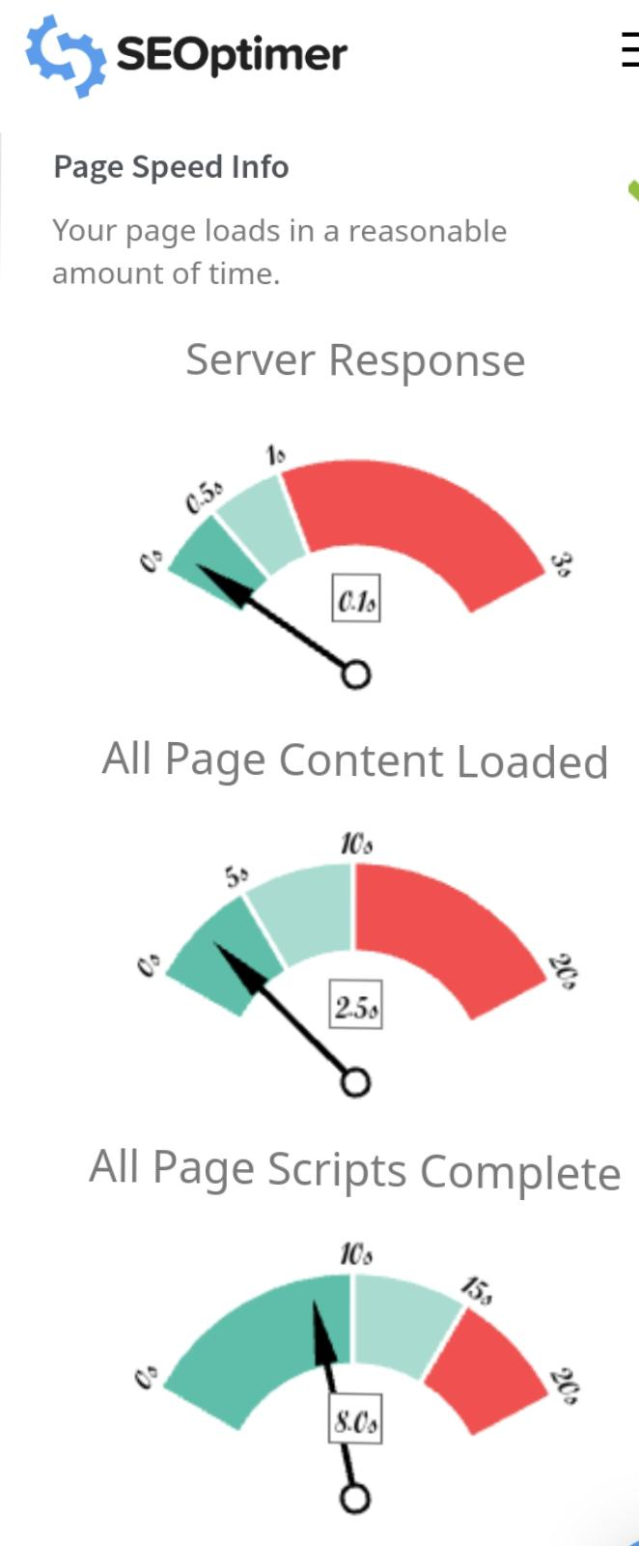

Slide 28
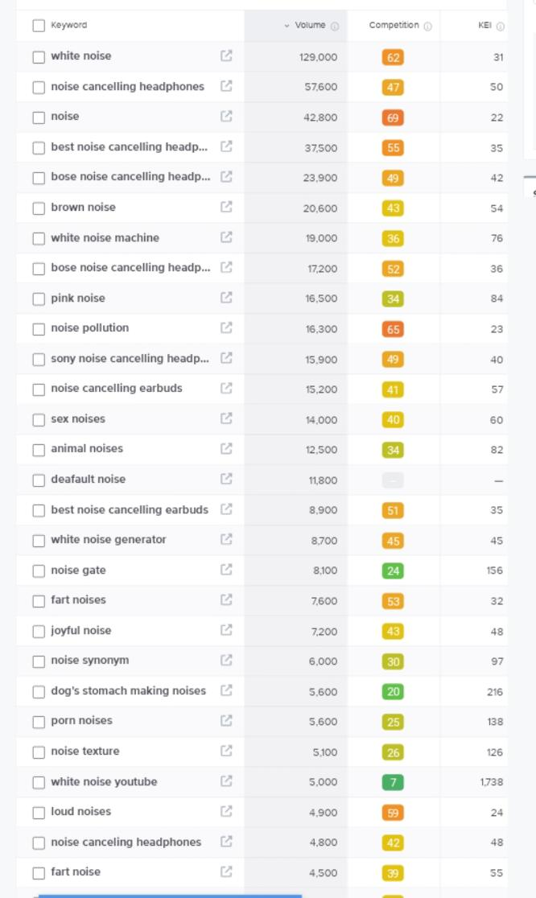
Keyword Research

Slide 29
On page optimisation
1. Keyword Research : Identify relevant keywords related to your brand, products, and industry. 2. Title Tags : Craft unique, descriptive titles for each page, incorporating primary keywords. 3. Meta Descriptions : Write compelling meta descriptions that summarize the content and encourage clicks.

Slide 30
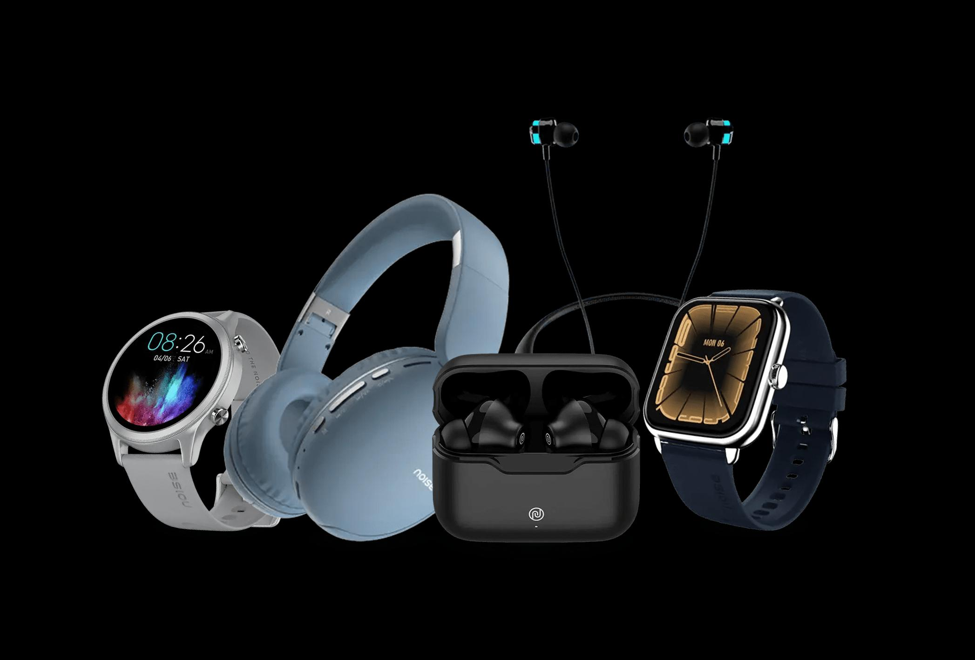
Content optimisation:
Content optimisation:
1.Know your audience :Understand who your target customers are, what they like, and what they are looking for in a brand like Noise.
2. Create engaging content: Develop content that is interesting, useful, and relevant to your audience, such as product reviews, tutorials, and lifestyle tips
3.Optimize for SEO :Use keywords strategically, optimize images and videos, and ensure fast loading speeds to improve search engine rankings.
4.Visual storytelling: Use high-quality images, videos, and graphics to showcase Noise products and lifestyle.

Slide 31
Key insights
1. Young and Bold: Noise is a brand for the young and bold, who want to make a statement with their accessories. 2.Innovative and Trendy: Noise is always innovating and keeping up with the latest trends, offering products that are cutting-edge and fashionable. 3. Customer-Centric Noise prioritizes its customers, offering excellent customer service and suppport. 4.Indian Roots: Noise is an Indian brand that takes pride in its heritage, offering products that are designed for the Indian market. 5.Growing Fast: Noise is a rapidly growing brand, expanding its presence online and offline.

Slide 32
Part-3 content ideas and marketing strategies

Slide 33
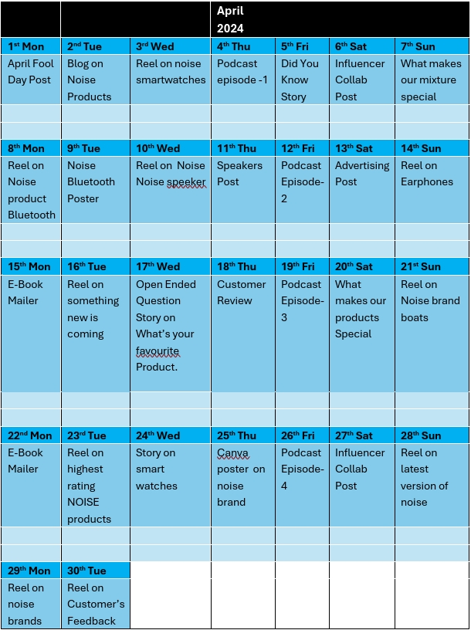
ContenT calender

Slide 34
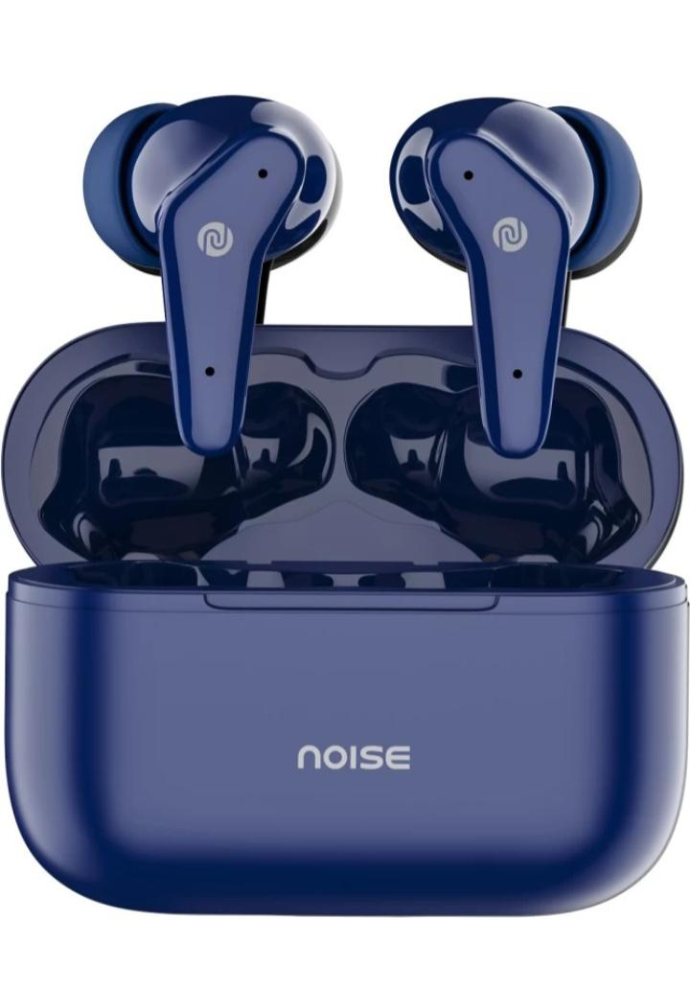
Content ideas
Content ideas:
1.Product Showcase : Highlight Noise products in action, showcasing their features and benefits. 2. Lifestyle Tips: Share tips on fitness, music, and style, aligning with the Noise brand values. 3. User Stories :Share stories of customers who have used Noise products to achieve their fitness or music goals.
4.How-To Guides: Create guides on how to use Noise products, such as setting up a smartwatch or using earbuds.
5. Product Reviews : Share honest reviews of Noise products from customers and experts.

Slide 35
Content strategies
1. Educational Content: Teach customers about Noise products, features, and benefits through blog posts, videos, and social media. 2. User-Generated Content: Encourage customers to share their Noise product experiences through photos, videos, and reviews. 3. Blog: Publish articles on fitness, music, and lifestyle topics, highlighting Noise products and expertise. 4.Video Content:Create product demos, tutorials, and lifestyle videos to engage customers and showcase products. 5.FAQs: Create a comprehensive FAQ section to answer common customer questions.

Slide 36
Part-4 content creation and content curation

Slide 37
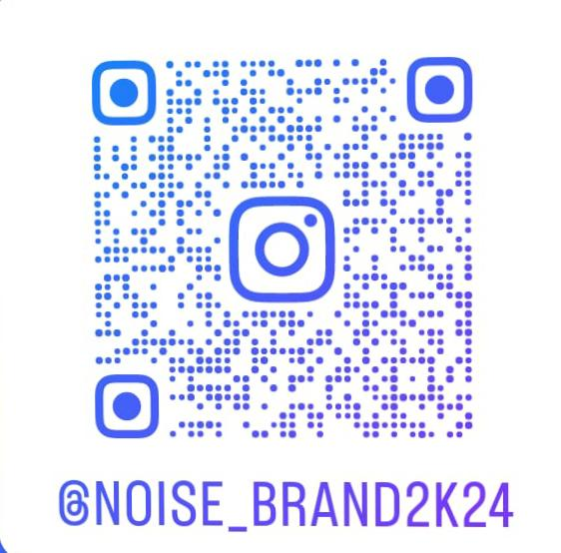
Instagram profile link
https://www.instagram.com/noise_brand2k24?utm_source=qr&igsh=MXNodHI3bmg0NjV0NA==

Slide 38
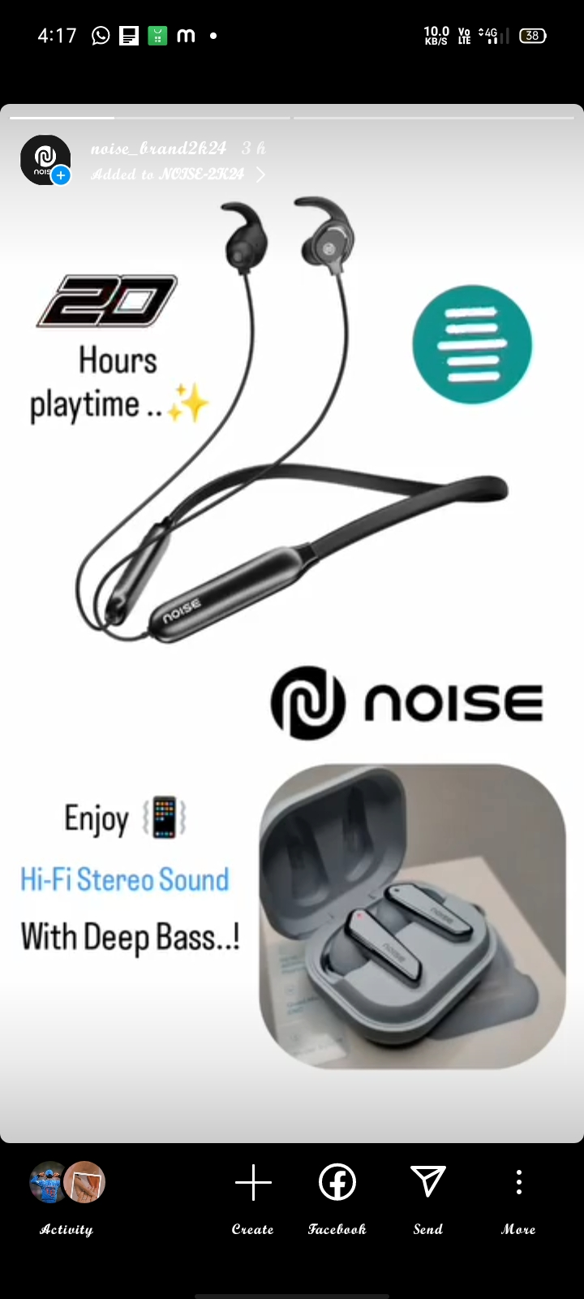
Instagram story highlight-1 link
Link-1:
https://www.instagram.com/s/aGlnaGxpZ2h0OjE3OTkxOTI2OTAzNDQ4MDAy?story_media_id=3352410009417501818_65946284110&igsh=MXN6dnVyOTFlMDV2OA==

Slide 39
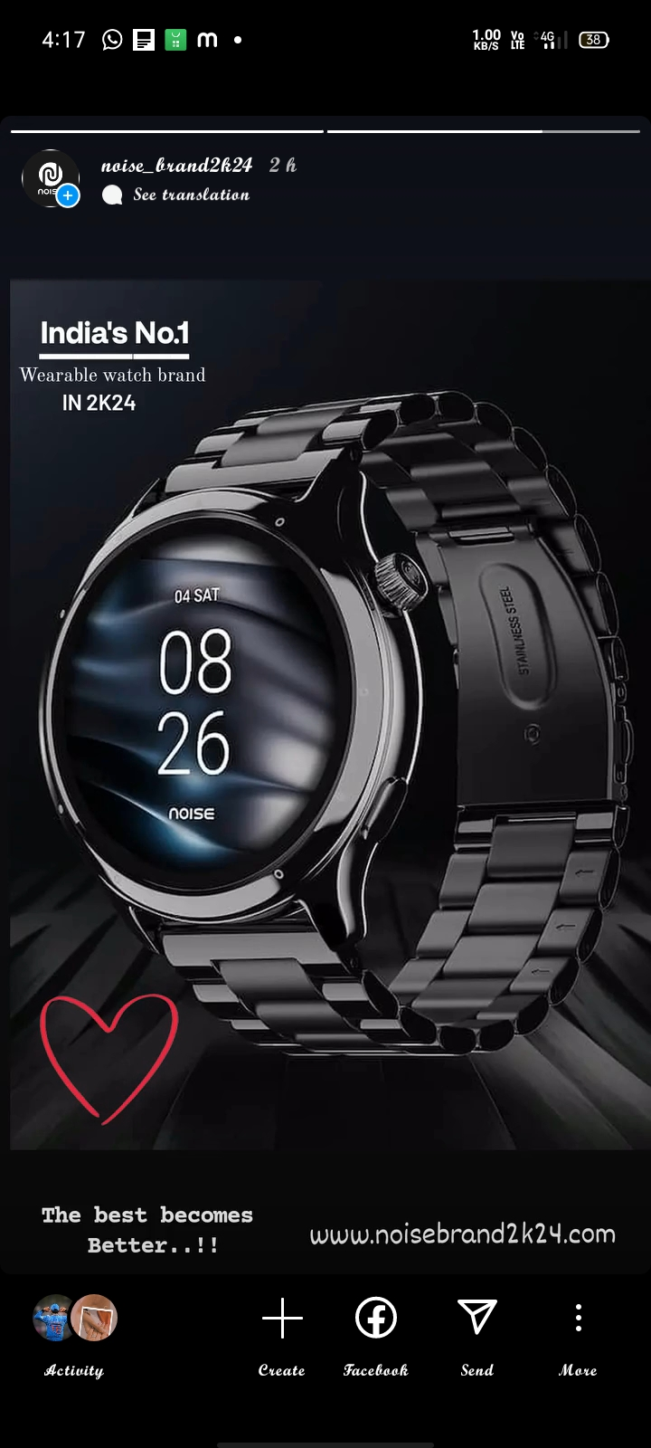
Story highlight -2 link
Link-2:
https://www.instagram.com/s/aGlnaGxpZ2h0OjE3OTkxOTI2OTAzNDQ4MDAy?story_media_id=3352451914406764463_65946284110&igsh=MXN6dnVyOTFlMDV2OA==

Slide 40
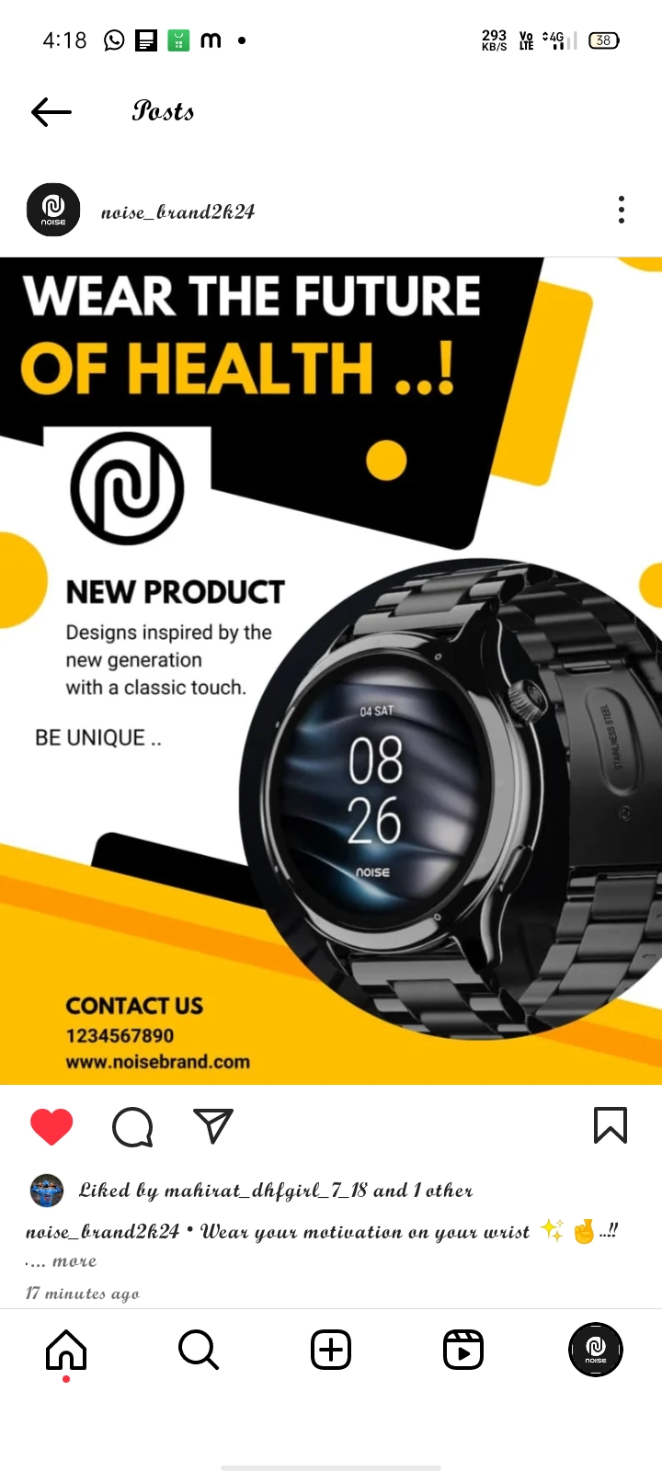
Post -1
Hashtags:
#Noisewear
#Noisewatches
#Noisestyle
#Noisefitness

Slide 41
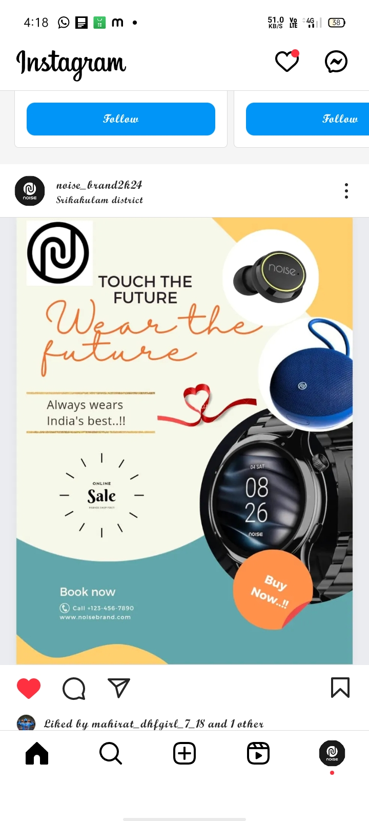
Post-2
Hashtags:
#Noisespeakers
#Noisemakers
#Wirelesssound
# Soundthatspeaks

Slide 42


